Slide 1

GENDER CLASSIFICATION USING A SPIDER WEB METHOD
Students: Salvatore Froncillo 0522500858
Pasqualino Gravina 0522500864

Slide 2
Introduction
Configurations
Preprocessing
Spider Web algorithm
Classifiers
SVM
Conclusions
Dataset
Neural Networks
Spider Web 2.0 algorithm
Further evidence
Conclusions
Targets
Project

Slide 3
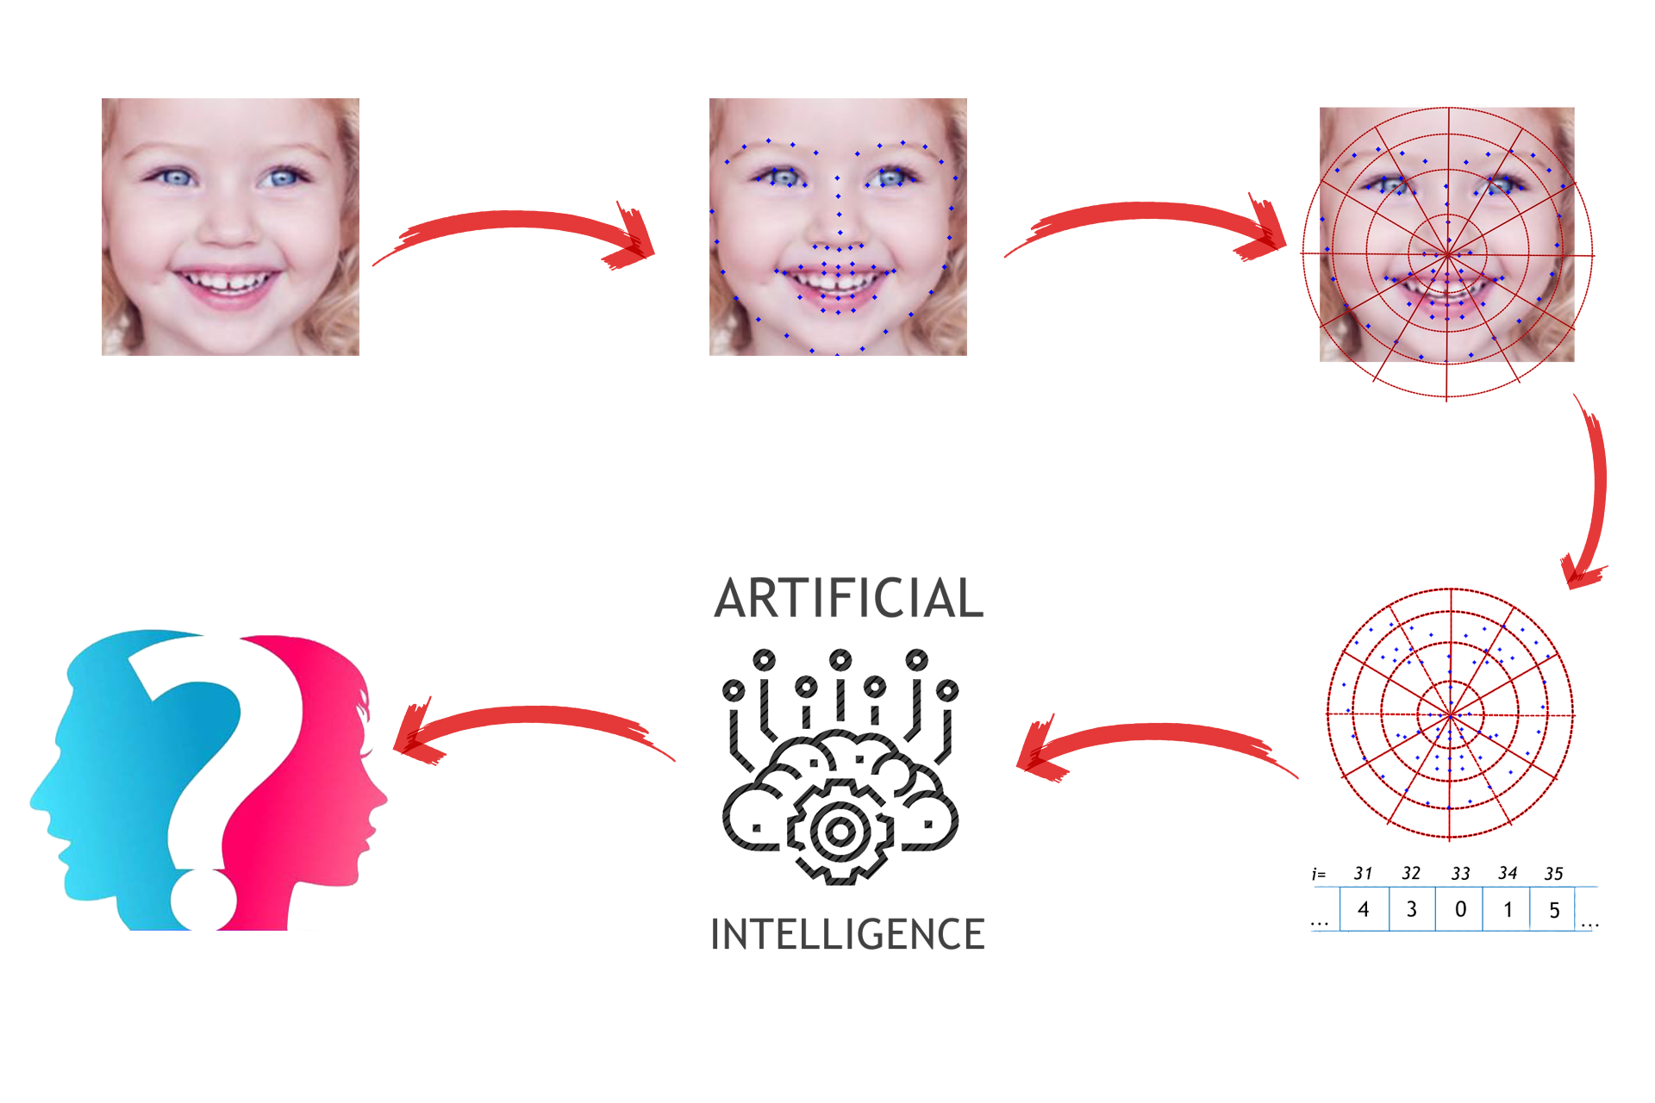
Gender Classification

Slide 4
Targets
Configurations
Use of spider webs in 4 different configurations:
Face Detection
Landmark extraction
Spider web application
Creation of 2 classifiers
Training classifiers
4C_4S_var4 (64 sectors)
4C_4S_var2 (64 sectors)
4C_3S_inv (48 sectors)
5C_4S_inv (80 sectors)

Slide 5
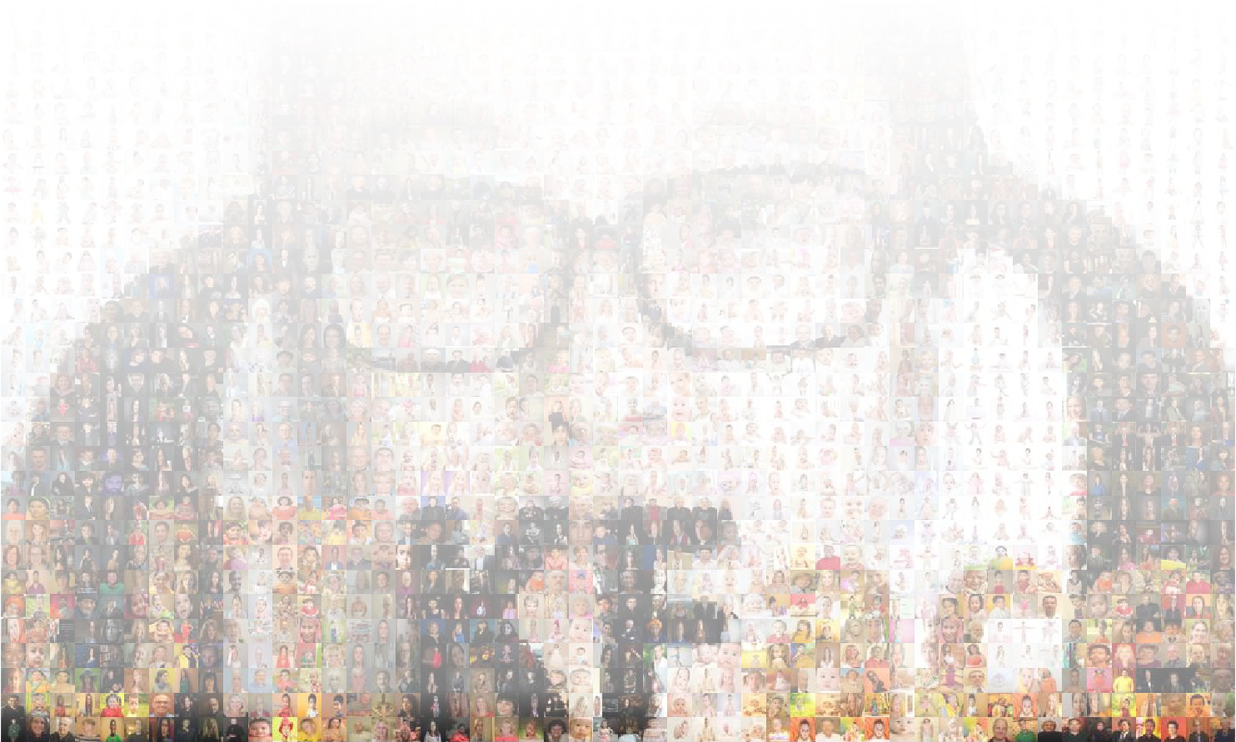
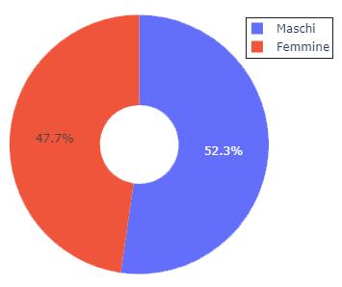
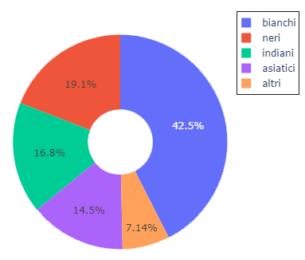
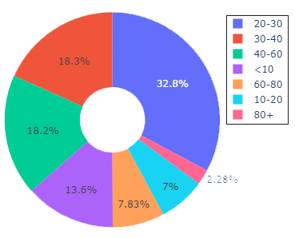
Dataset - UTKFace

Slide 6
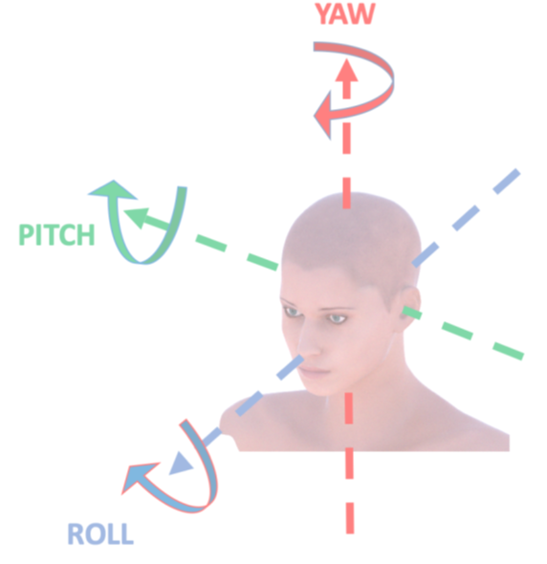
Spider web algorithm
The algorithm provided at the start has the pose estimation as its goal.
For the purposes of our project, the algorithm is supportive for:
Face Detection Operation;
extraction of the 68 landmarks of the face;
assignment of each landmark to the sector of the web.

Slide 7
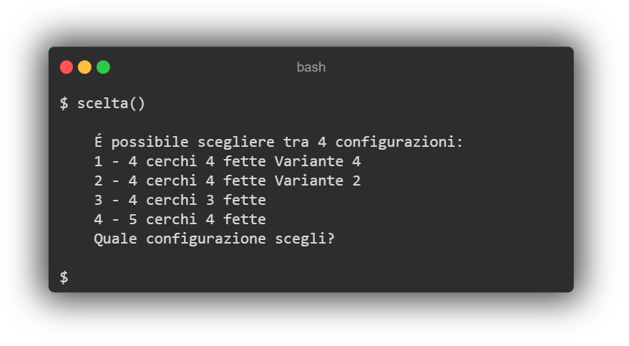
Spiderweb Algorithm 2.0 (1)
Responsive configuration
choice () function has been added , which allows you to choose from the command line which web configuration to apply to the dataset.
To make the algorithm totally responsive, it was also advisable to partially modify the existing add () function.

Slide 8
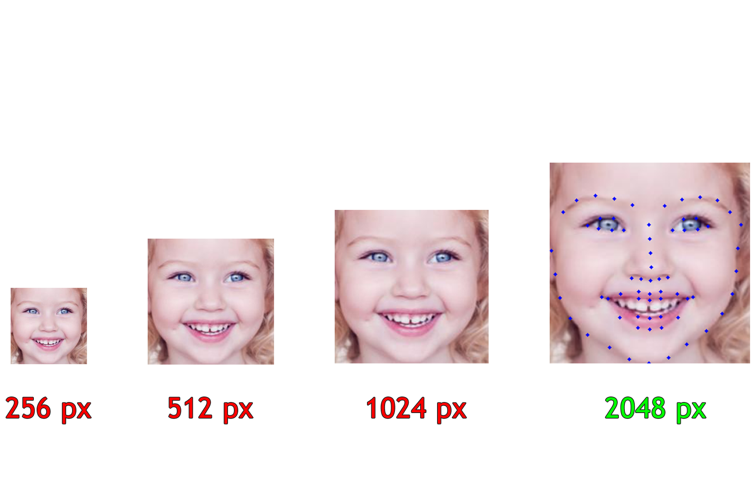
Spiderweb Algorithm 2.0 (2)
Responsive Resize
To take advantage of all the “usable” images, it was decided to gradually increase the resolution of the images whenever it was not possible, at a given resolution starting from 256 pixels, to recognize a face.

Slide 9
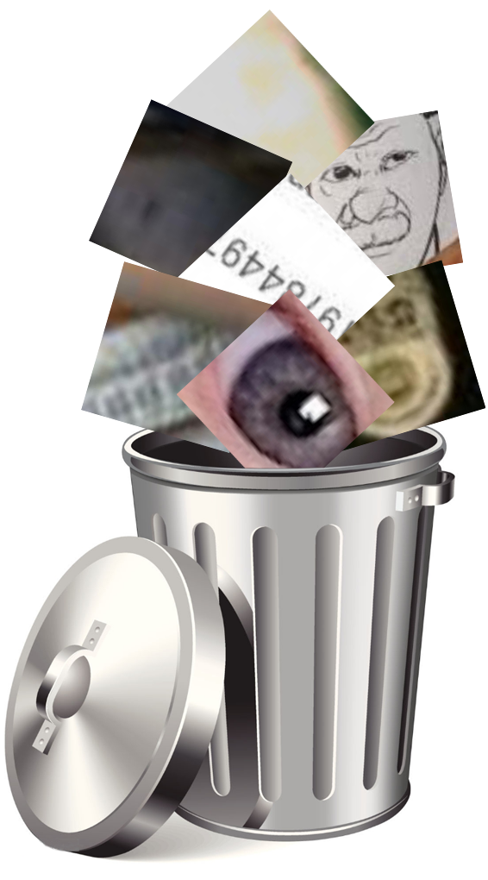
Spiderweb Algorithm 2.0 (3)
Unusable image analysis
Despite the use of the responsive_resize () function about 1% of the images are discarded.
On subsequent analysis, impurities were found in the dataset:
partially covered faces,
images with only eyes,
objects not inherent in faces.

Slide 10
SVM classifier
Support Vector Machines (SVM) are supervised learning models associated with learning algorithms for classification and regression.
Configuration | Accuracy
4C_4S_var4 | 0.72
4C_4S_var2 | 0.73
5C_4S_inv | 0.74
4C_3S_inv | 0.71
The accuracy found using this type of classifier is 0.74

Slide 11
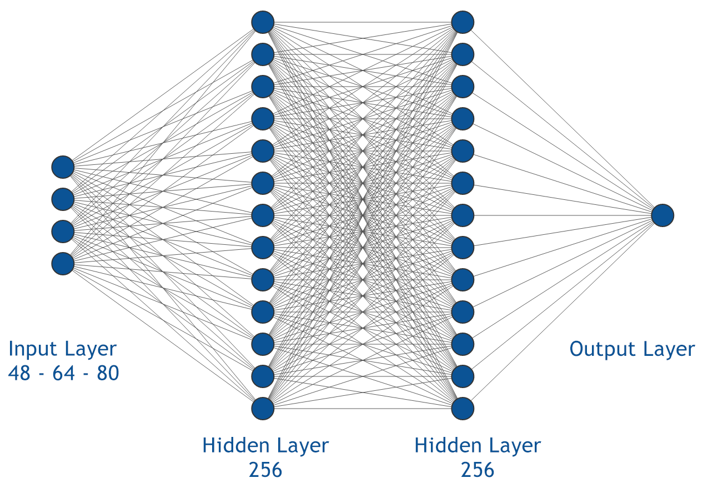
Neural Network (1)

Slide 12
Neural Network (2)
After having developed 4 classifiers for the related configurations, we can say that even with the use of neural networks it was not possible to obtain an accuracy percentage greater than 0.75.
Configuration | Loss | Accuracy
4C_4S_var4 | 0.54 | 0.72
4C_4S_var2 | 0.54 | 0.73
5C_4S_inv | 0.50 | 0.75
4C_3S_inv | 0.55 | 0.70
It was also attempted to add the two features regarding age and race of the faces to the spider web array, without noticing significant improvements.

Slide 13
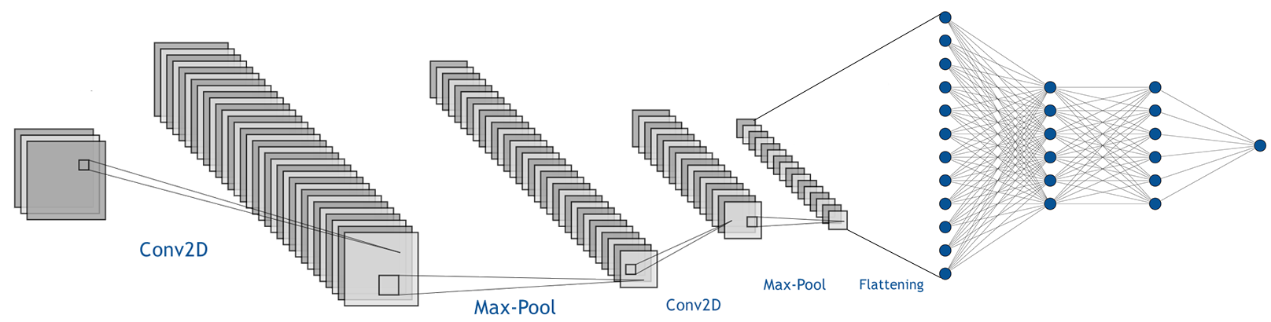
Convolutional
Convolutional neural network model with dataset image only input
The accuracy found using this type of neural network is 0.88

Slide 14
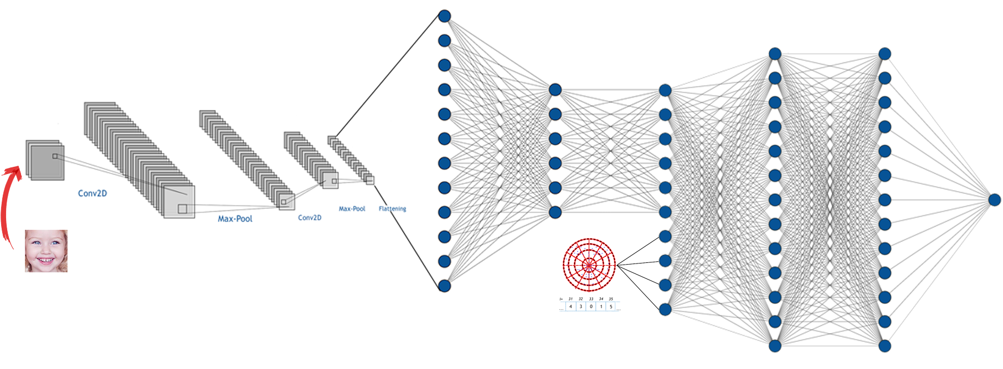
'HYBRID' Neural Network (1)
The 'hybrid' neural network concatenates the convolutional network with the neural network with input the web in the phase in which the convolutional network is fully connected .

Slide 15
'HYBRID' Neural Network (2)
Configuration | Loss | Accuracy
4C_4S_var4 | 0.25 | 0.89
4C_4S_var2 | 0.27 | 0.88
5C_4S_inv | 0.27 | 0.88
4C_3S_inv | 0.26 | 0.88
The accuracy found using this type of neural network is 0.89

Slide 16
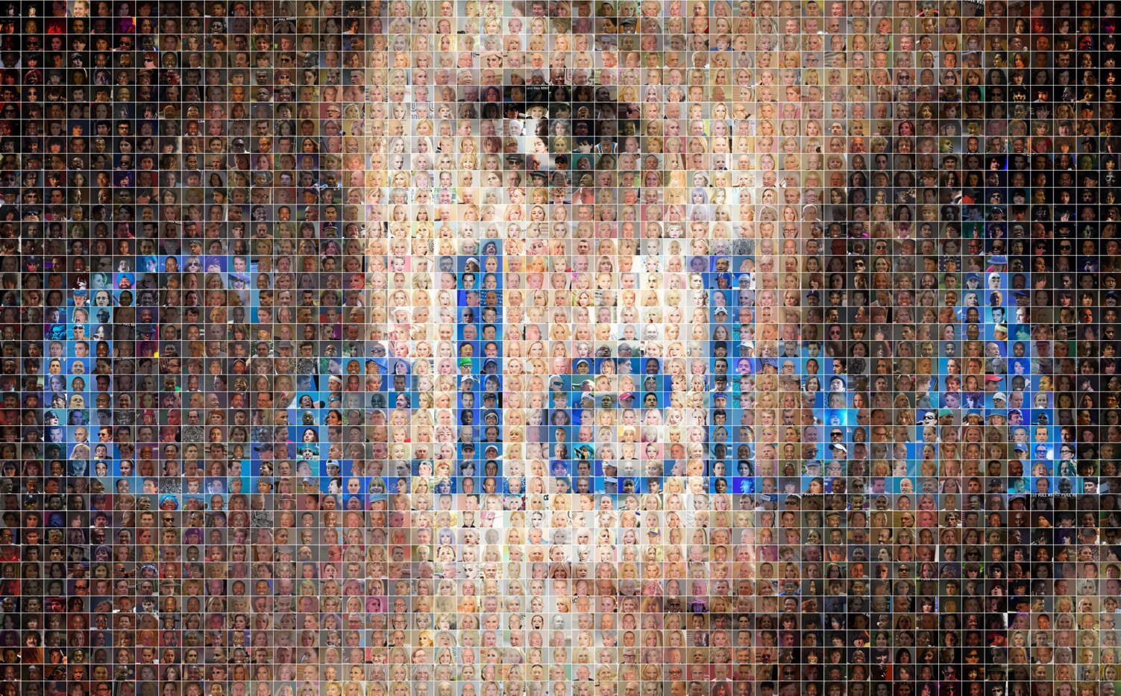
Further evidence - CelebA dataset
CelebFaces Attributes Dataset ( CelebA ) is a large-scale attribute face dataset with over 200,000 celebrity images, each with 40 attribute annotations.
Using this dataset, a neural network model was trained with the best configuration previously obtained.
Configuration | Loss | Accuracy
5C_4S_inv | 0.42 | 0.81

Slide 17
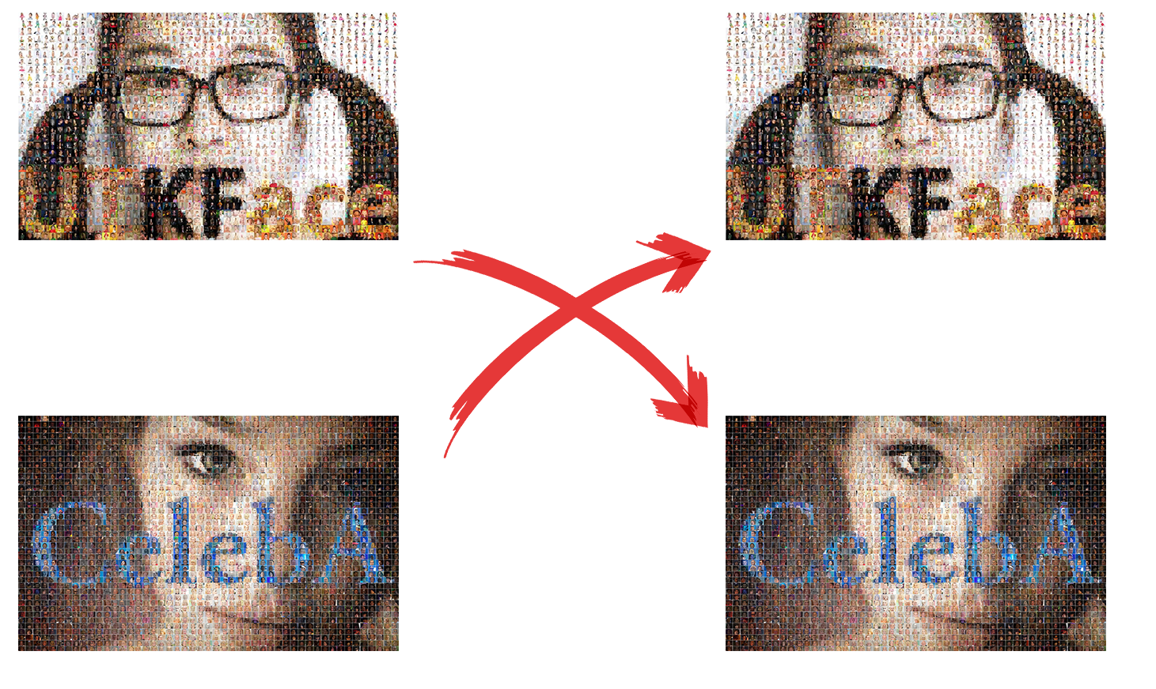
Cross tests (1)
Training Set
Test
Notes:
PROVISIONAL

Slide 18
Cross tests (2)
Classifier trained on | Test dataset | Accuracy
UTKFace | UTKFace | 0.74
CelebA | CelebA | 0.81
UTKFace | CelebA | 0.74
CelebA | UTKFace | 0.73
UTKFace
CelebA
Age ranging between 0 and 116 years;
diversified breed distribution.
Narrow age range, which does not include childhood and old age faces.

Slide 19
Conclusions
SVM Accuracy Classifier : 0.74
Neural Network with Spider Web ( UTKFace ) Accuracy : 0.75
Convolutional Neural Network Images Accuracy : 0.88
'Hybrid' Neural Network Accuracy : 0.89
Neural Network with Spider Web ( CelebA ) Accuracy : 0.81

